Slide 1
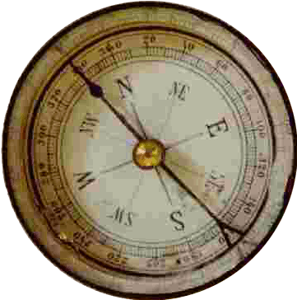
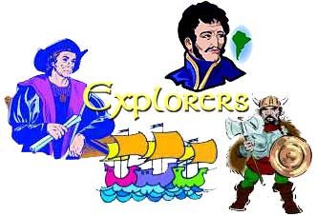
European Exploration of North & South America
Notes:
The effects of early exploration on the indigenous people of North and South America
https://www.facinghistory.org/holocaust-and-human-behavior/chapter-2/first-encounters-americas
https://www.history.com/topics/exploration/exploration-of-north-america

Slide 2
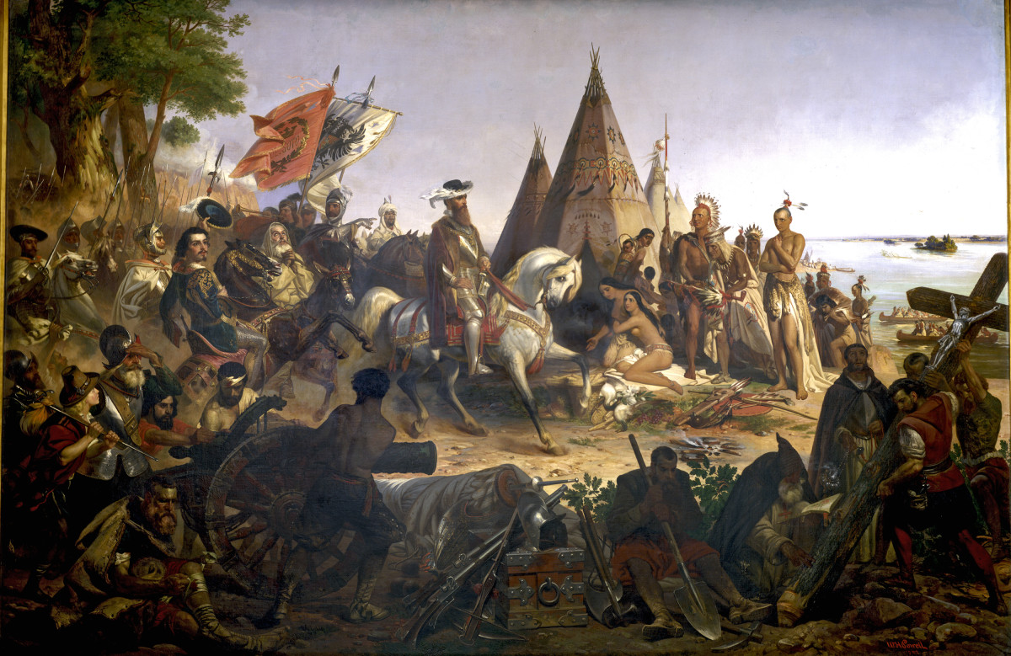
4th grade - September 2010
Describe European exploration in North America.
Describe the reasons for, obstacles to, and travels of the Spanish, French, and English explorations of John Cabot, Vasco Núñez de Balboa, Juan Ponce de León, Christopher Columbus, Henry Hudson, and Jacques Cartier.
b. Describe examples of cooperation and conflict between Europeans and Native Americans.

Slide 3
Exploration Timeline
1st century AD – Chinese invent the first compass
120 AD – Ptolemy creates first flat map of world
982 – Eric the Red arrived in Greenland
1002 – Leif Ericson arrived in North America
1271 – 1295 Marco Polo goes to China
1453 – Turkish Empire cuts off land route for spices from Asia to Europe
and the search begins….

Slide 4
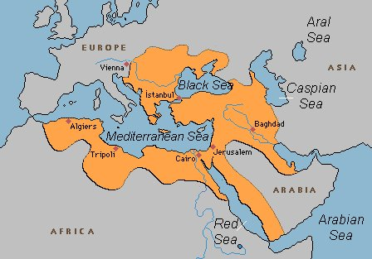
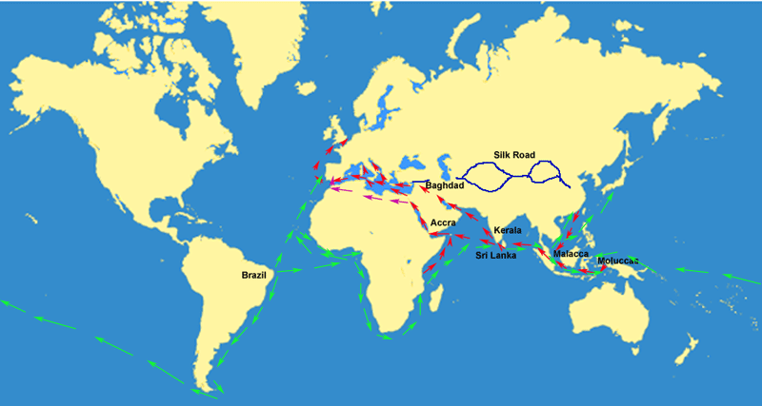
1271 – 1295 Marco Polo goes to China
1453 – Turkish Empire cuts off land route for spices from Asia to Europe
and the search begins….

Slide 5
English Spanish
John Cabot (Italian)
Sebastian Cabot
James Cook
Sir Francis Drake
Henry Hudson (for the Dutch)
Vasco Núñez de Balboa
Juan Cabrillo (Portuguese
Christopher Columbus (Italian)
Francisco Coronado
Hernando de Soto
Francisco Pizarro
Juan Ponce de León

Slide 6
French Portuguese
Jacques Cartier
Samuel de Champlain
Rene Robert de Lasalle
Prince Henry the Navigator
Juan Cabrillo (for Spain)
Vasco Da Gama
Ferdinand Magellan

Slide 7
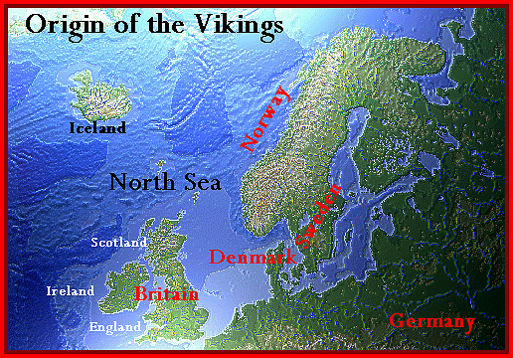
Italian Norse
John Cabot (for England)
Christopher Columbus (for Spain)
Marco Polo
Amerigo Vespucci
Leif Erikson (Norse)
Vikings (Norse)
Norse = Scandinavian

Slide 8
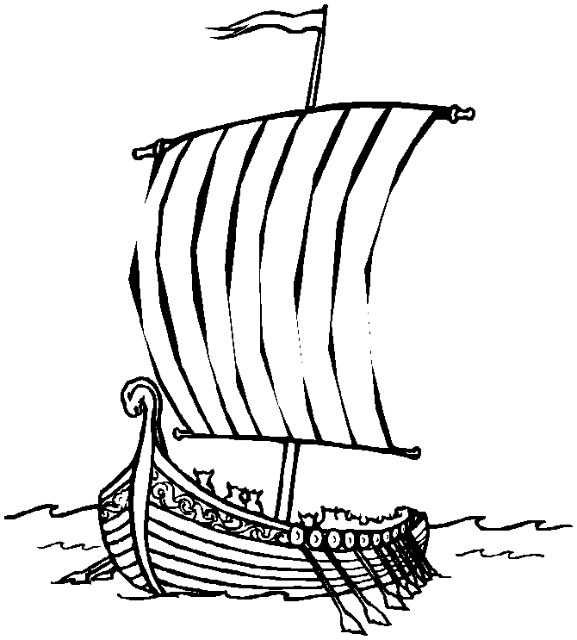
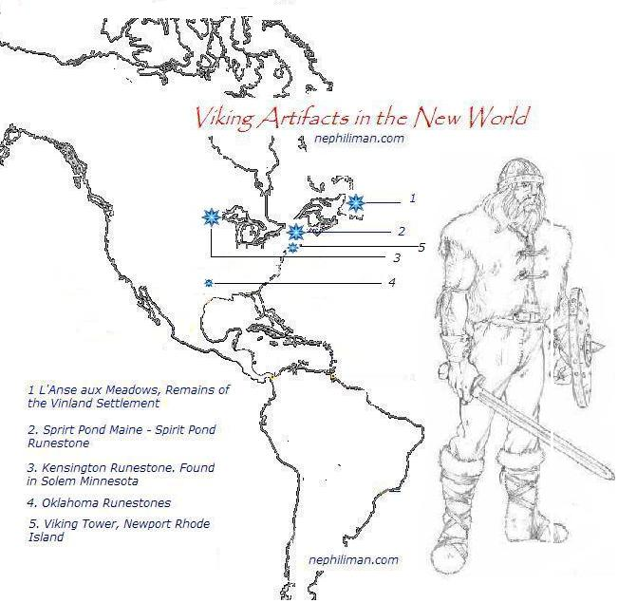

Slide 9
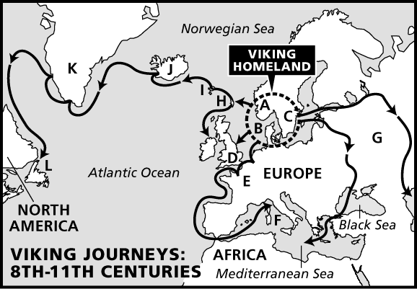
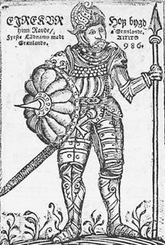
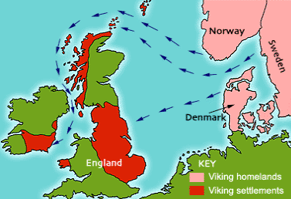
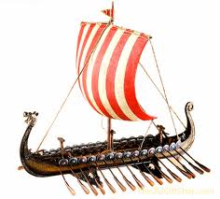

Slide 10
1271 – 1295 Marco Polo goes to China
1453 – Turkish Empire cuts off land route for spices from Asia to Europe
and the search begins….
1492 – Columbus sails to the North & South America

Slide 11
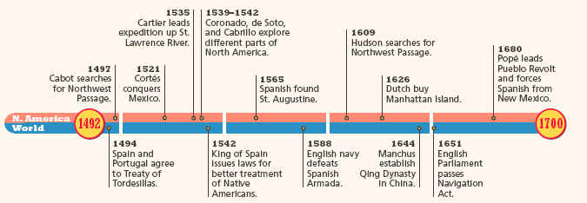
During the 1500s (16th century) and 1600s
(17th century) European countries began
Exploring across the Atlantic. Christopher
Columbus was one of the first explorers to
attempt this. His travels sparked the
interest of exploration in many other countries.

Slide 12
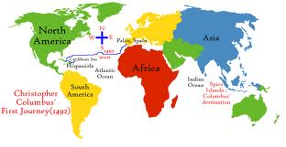
Christopher Columbus (1451-1506)
was an Italian explorer who sailed across the
Atlantic Ocean in 1492, hoping to find a route to
India.
He made a total of four trips to the Caribbean
And South America during the years 1492-1504

Slide 13
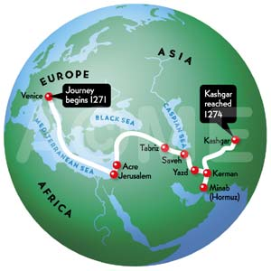
While on a voyage for Spain in search of a direct sea route from Europe to Asia, Columbus unintentionally arrived in the Americas. However, in four separate voyages to the Caribbean from 1492 to 1504, he remained convinced that he had found the lands that Marco Polo reached in his overland travels to China at the end of the 13th century.

Slide 14
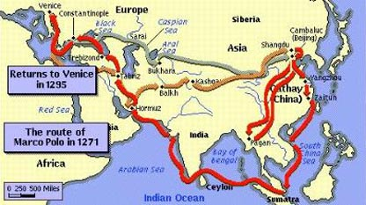

Slide 15
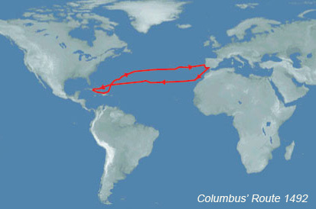
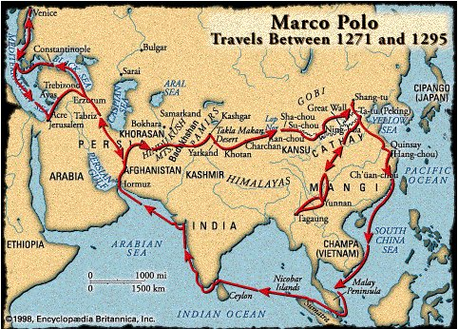

Slide 16
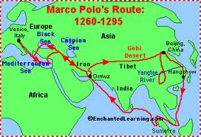
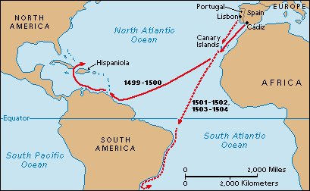
Columbus

Slide 17
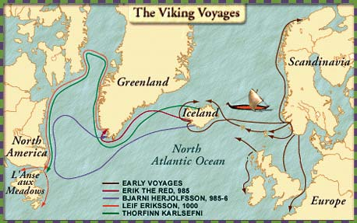
Columbus is mistakenly credited with being the first to reach Americas from Europe, but he was not the first. He followed at least one group, the Norse, which were led by Leif Ericson. Ericson built a temporary settlement around 500 years earlier.

Slide 18
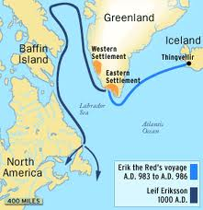
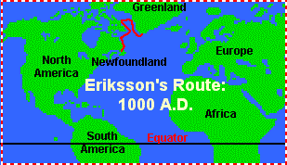
Because of Columbus’ travels, a culture of colonization and genocide of indigenous people began in North and South America.

Slide 19
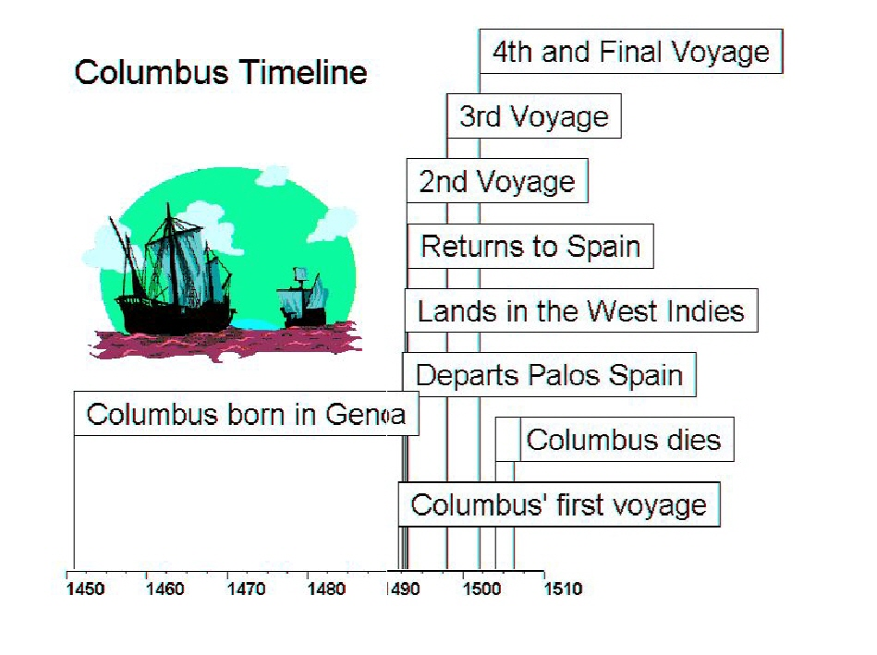

Slide 20
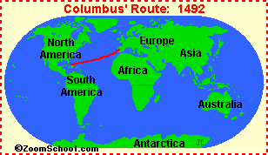
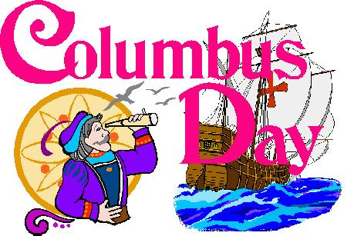
Today Columbus Day is celebrated on October 12 in Spain and throughout the Americas, with the exception of Canada. In the United States, it is observed on the second Monday in the month of October.

Slide 21
Columbus Day?
Columbus Day was started in 1937 by President Franklin Roosevelt. Today, many years later, the holiday is looked at as a very controversial day. Many people believe that the day is glorifying a person that sparked the genocide of indigenous peoples throughout North and South America. There is a movement to rename it Indigenous Peoples Day. What do you think?

Slide 22
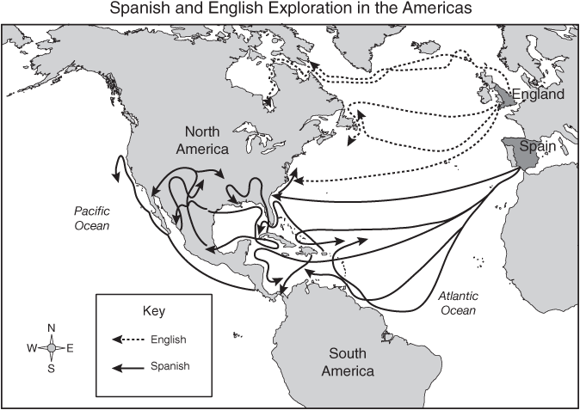
After Columbus returned to Spain, other European explorers began voyages. In 1497 John Cabot explored the coasts of Labrador, Newfoundland, and New England. Juan Ponce de León explored Florida and part of the Yucatán Peninsula in the early 1500s. In 1519 Hernán Cortés invaded Mexico and subsequently spent several years conquering the Aztecs.

Slide 23
Exploration Timeline
1st century AD – Chinese invent the first compass
120 AD – first flat map of world
982 – Eric the Red discovers Greenland
1002 – Leif Ericson discovers North America
1271 – 1295 Marco Polo goes to China
1453 – Turkish Empire cuts off land route for spices from Asia to Europe
1492 – Columbus sails to New World
1497 – John Cabot discovers Newfoundland while searching for the “Northwest Passage” to Asia.

Slide 24
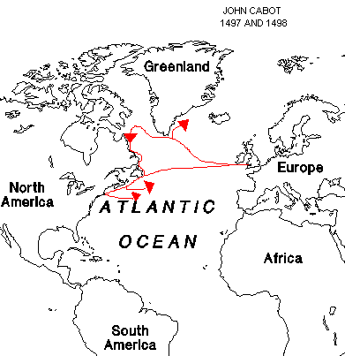
John Cabot born 1450 died 1499 Italian who sailed for England
He was the first European since
the Vikings to explore the mainland of North America and the first to search for the “Northwest Passage” to China.

Slide 25
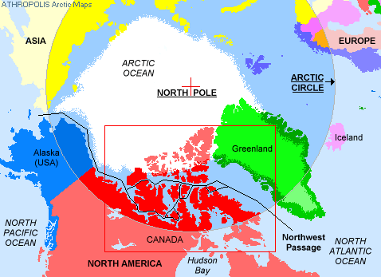

Slide 26
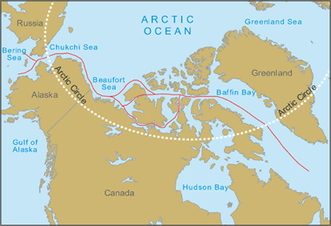
John Cabot’s original name is Giovanni Caboto. He moved to England in 1495 when his requests to get funding for a voyage across the Atlantic to find the “northwest passage” to China were turned down.

Slide 27
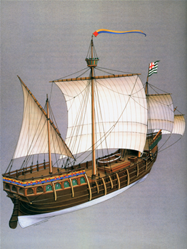
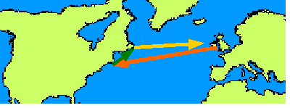
Finally, at the request of King Henry VII of England, Cabot sailed in 1497, commanding the small ship called "Matthew."

Slide 28
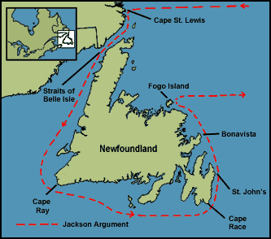
Cabot landed near Labrador, Newfoundland, on June 24, 1497. One of John Cabot's three sons, the explorer Sebastian, accompanied him on this trip. Cabot claimed the land for England.
Cabot did not find China. He had found Canada by mistake. He named this land “New Found Land.” .

Slide 29
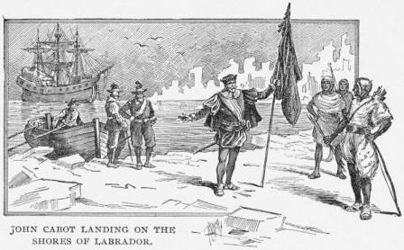
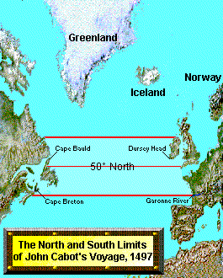

Slide 30
Exploration Timeline
1st century AD – Chinese invent the first compass
120 AD – first flat map of world
982 – Eric the Red discovers Greenland
1002 – Leif Ericson discovers North America
1271 – 1295 Marco Polo goes to China
1453 – Turkish Empire cuts off land route for spices from Asia to Europe
1492 – Columbus sails to New World
1497 – John Cabot discovers Newfoundland
1502 – Amerigo Vespucci returns from exploration of North and South America; American continents named after him by German mapmaker
1513 – Balboa arrives on the eastern shore of Pacific Ocean

Slide 31
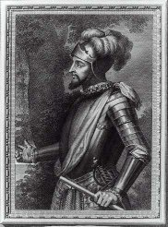
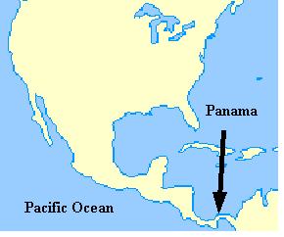
He was the first European to see (and stand in the waters of) the eastern shore of the Pacific Ocean, on September 13, 1513. He accomplished this after a arduous trek through the jungles of what is now Panama.
Vasco Núñez de Balboa Spanish
Born: 1475 Died: 1519

Slide 32
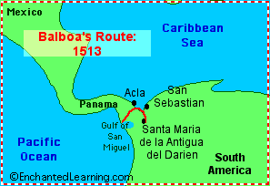
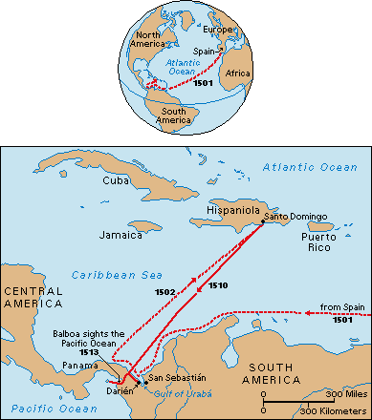

Slide 33
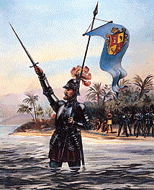
Vasco Núñez de Balboa claimed the Pacific Ocean and all its shores for Spain, which opened the way for Spanish exploration and conquest along the western coast of South America. But it was the Portuguese explorer, Magellan who, because its waters seemed so calm, gave this ocean the name "Pacifica" (meaning peaceful).

Slide 34
Exploration Timeline
1st century AD – Chinese invent the first compass
120 AD – flat map of world
982 – Eric the Red - Greenland
1002 – Leif Ericson arrives in North America
1271 – 1295 Marco Polo goes to China
1453 – Turkish Empire cuts off land route
1492 – Columbus sails to New World
1497 – John Cabot arrives in Newfoundland
1502 – Amerigo Vespucci returns from exploration of New World; American continents named after him by German mapmaker
1513 – Balboa discovers eastern shore of Pacific Ocean
1513 - Ponce de León searches for the Fountain of Youth

Slide 35
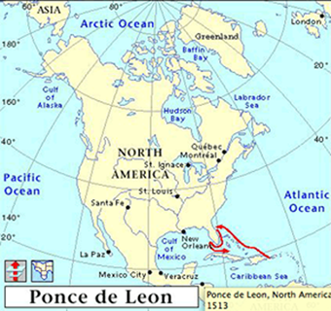
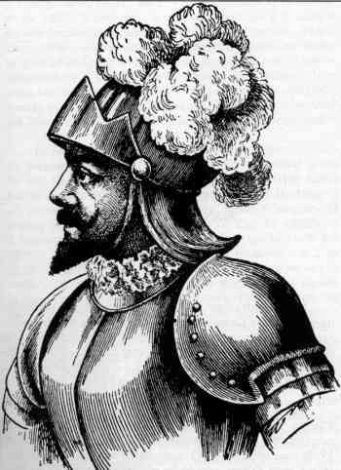
Juan Ponce de León – 1460 – 1521 Spain

Slide 36
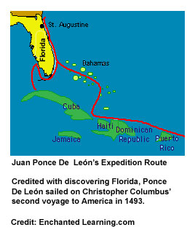
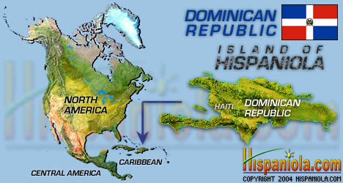
Ponce de León and his family settled on an island named Hispaniola (Dominican Republic).
He became a military commander on Hispaniola and was appointed deputy governor.
Notes:
https://www.history.com/topics/exploration/juan-ponce-de-leon
https://slideplayer.com/slide/4473942/
https://gsp.yale.edu/case-studies/colonial-genocides-project/puerto-rico

Slide 37
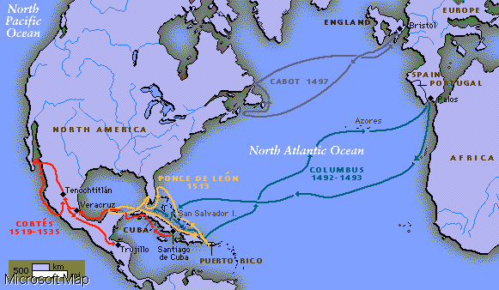

Slide 38
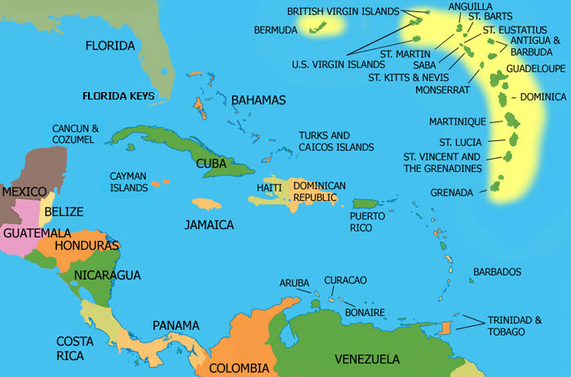
In 1506, Ponce de León landed on an island. While there, he found large deposits of gold.
Soon after his arrival, he left the island. He returned in 1508 on orders from the king of Spain to explore and colonize the island. He renamed the island Puerto Rico. He was the island's governor for two years until the king replaced him with Columbus' son.

Slide 39
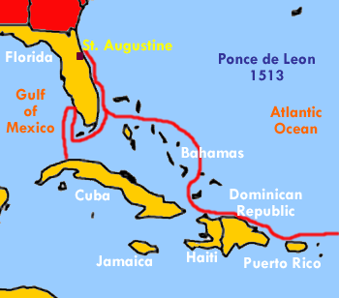
Hurt by the King's action, Ponce de León sailed again -- north through the Bahamas towards Florida. He was in search of new lands and treasures.

Slide 40
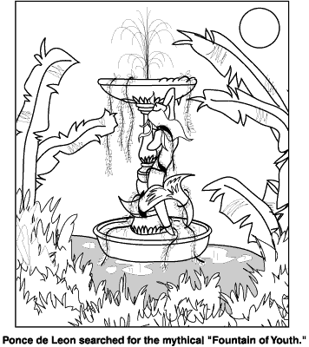
He had also heard of a mythical fountain of youth. Native Americans spoke of a legendary, magical spring whose water was believed to make older people young again. Ponce de León explored many areas, including the Bahamas and Bimini, for both gold and the mythical fountain, but he found neither.

Slide 41
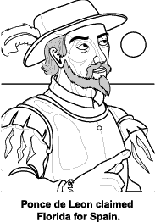
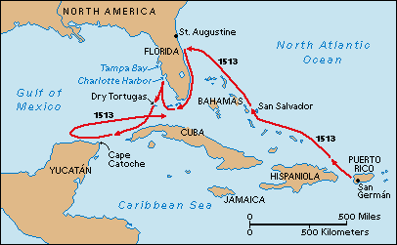
In March of 1513, his ships landed near present-day St. Augustine. He claimed it for Spain. He named it La Florida (LAH flow REE dah) or "place of flowers.”

Slide 42
In 1513, Juan Ponce de León explored
and then claimed Florida for the Spanish crown.

Slide 43
Exploration Timeline
1st century AD – Chinese invent the first compass
120 AD – flat map of world
982 – Eric the Red - Greenland
1002 – Leif Ericson arrives at North America
1271 – 1295 Marco Polo goes to China
1453 – Turkish Empire cuts off land route
1492 – Columbus sails to New World
1497 – John Cabot arrives at Newfoundland
1502 – Amerigo Vespucci returns from exploration of New World; American continents named after him by German mapmaker
1513 – Balboa arrives at eastern shore of Pacific Ocean
1513 - Ponce de León searches for the Fountain of Youth
1519 – 1522 – Ferdinand Magellan and crew sail around the world
1534 – Cartier arrives at the St Lawrence River and the Great lakes

Slide 44
Jacques Cartier was born in France.
Not much is known of his life before 1534, when he departed on his first voyage. He was looking for a passage through or around North America to East Asia.

Slide 46
Cartier made three voyages for France to the North
American continent between 1534 and 1542. He
explored the St. Lawrence River and gave Canada
its name.

Slide 48
Exploration Timeline
1492 – Columbus sails to New World
1497 – John Cabot arrives Newfoundland
1502 – Amerigo Vespucci returns from exploration of New World; American continents named after him by German mapmaker
1513 – Balboa arrives eastern shore of Pacific
1513 - Ponce de León searches for the Fountain of Youth
1519 – 1522 – Ferdinand Magellan and crew sail around the world
1534 – Cartier arrives at the St Lawrence River and the Great lakes
1539 – 1542 – Hernando De Soto explorers southeastern U.S.
1577 – Sir Francis Drake becomes first European to sail around the world

Slide 49
Henry Hudson was the first European to explore the Hudson River throughout its navigable length and leave behind a detailed description of his voyage.

Slide 51
Henry Hudson: an Englishman in Dutch service 1565 - 1611
The HALF MOON was owned by Dutch East
India Company and sailed by Henry Hudson.
Hudson sailed northeast in April 1609.
When blocked by ice, he disregarded
Orders and sailed his ship across the
Atlantic to search for a Northwest
Passage. On this voyage he sailed
up the Hudson River as far as Albany
-- giving the Dutch their claim to the
area.

Slide 53
-the Hudson River,
Hudson Strait, and Hudson
Bay – are all named after him

Slide 54
While, Hudson is credited with “discovering” the location which is now New York City (although da Verrazzano had previously sailed by the area in 1524). Hudson sailed into New York's harbor on September 3, 1609 and noted what an excellent harbor it was. He sailed up the river 150 miles and noted the rich land, but realized it was not a waterway to India. His reports resulted in many Dutch settlements in the area.

Slide 58
There are many myths surrounding Columbus’ voyages. He did not set out to prove the Earth was round; by then, everyone knew that it was not flat. The Queen did not sell the crown jewels to fund any of his voyages and Columbus never saw the mainland United States. Some people also resent that Columbus was credited with “discovering America”. In fact, a Norse village dating back around 1003 was discovered in 1960, meaning that the Norse were the first Europeans to set foot in the Americas.

